Slide 1
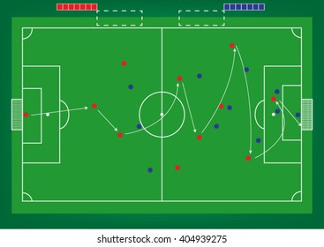
w6=0.20
w4=0.05
w8=0.30
w1=0.05
w2=0.05
w3=0.10
w5=0.15
w7=0.20

Slide 2
w5=0.5
w4=-0.1
w1=0.1
w1=-0.5
w2=0.9
w3=0.7
w5=-0.5
w1=0.9

Slide 3
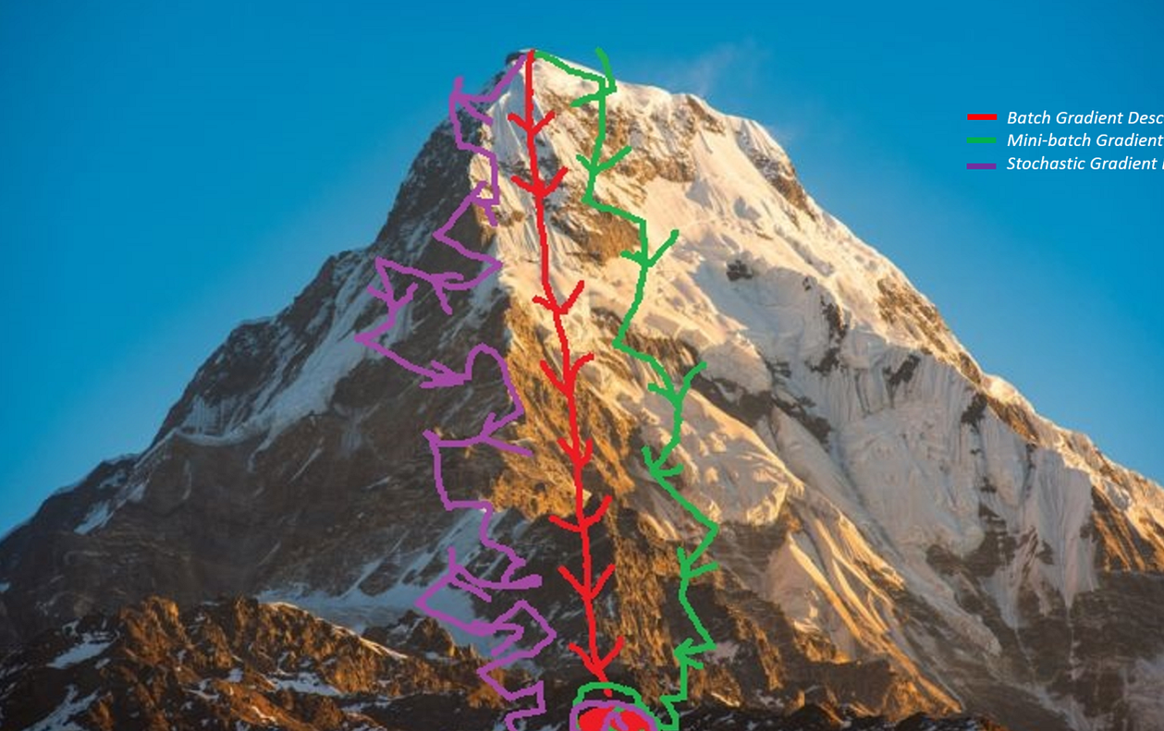



Slide 4
Gradient descent
بسم الله الرحمن الرحيم

Slide 5
g
y
z
Target = 10
g = -2*w1
y = w2 + g
z = y*w3
Predicted = -10
Loss = 20
z = (w2 + -2*w1)*w3
w1 = 3
w2 = 4
w3 = 5
dz / dw1 = dz/dy * dy/dg * dg/dw1 = -10
dz / dw2 = dz/dy * dy/dw2 = w3 * 1 = w3 = 5
dz / dw3 = y = w2 + g = w2 - 2*w1 = 4 - 2*3 = -2
Gradient Descent STARTS…

Slide 6
g = -2*w1
y = w2 + g
z = y*w3
g
y
z
Target = 10
w1
z
dz / dw1 = -10 affect of w1 on z
dz / dw2 = 5 affect of w2 on z
dz / dw3 = -2 affect of w3 on z
w2
z
w3
z
GOAL!!!
Loss = 20
Predicted = -10

Slide 7
g = -2*w1
y = w2 + g
z = y*w3
g
y
z
Target = 10
w1 = 3
w2 = 4
w3 = 5
dz / dw1 = -10
dz / dw2 = 5
dz / dw3 = -2
Predicted = -10
Learning rate
w1
w1 = 3 + 0.01*(-10) = 2.9
w2
w2 = 4 + 0.01*5 = 4.1
w3
w3 = 5 + 0.01*(-2) = 4.9

Slide 8
g = -2*w1
y = w2 + g
z = y*w3
g
y
z
Target = 10
w1 = 3
w2 = 4
w3 = 5
z = (w2 + -2*w1)*w3
Predicted = z = (4.1 – 2 * 2.9) * 4.9 = -8.33
This is one step!!
w1 = 3 + 0.01*(-10) = 2.9
w2 = 4 + 0.01*5 = 4.1
w3 = 5 + 0.01*(-2) = 4.9

Slide 9
g = -2*w1
y = w2 + g
z = y*w3
g
y
z
Target = 10
Predicted = -8.33
w1 = 3
w2 = 4
w3 = 5
dz / dw1 = -10
dz / dw2 = 5
dz / dw3 = -2
z = (w2 + -2*w1)*w3
1
Calculate the prediction
w1 = 3 + 0.01*(-10) = 2.9
w2 = 4 + 0.01*5 = 4.1
w3 = 5 + 0.01*(-2) = 4.9

Slide 10
g = -2*w1
y = w2 + g
z = y*w3
g
y
z
Target = 10
Predicted = -8.33
w1 = 3
w2 = 4
w3 = 5
dz / dw1 = -10
dz / dw2 = 5
dz / dw3 = -2
z = (w2 + -2*w1)*w3
1
Calculate the prediction
2
Calculate the loss
Loss = target - predicted
w1 = 3 + 0.01*(-10) = 2.9
w2 = 4 + 0.01*5 = 4.1
w3 = 5 + 0.01*(-2) = 4.9

Slide 11
g = -2*w1
y = w2 + g
z = y*w3
g
y
z
Target = 10
Predicted = -8.33
w1 = 3
w2 = 4
w3 = 5
dz / dw1
dz / dw2
dz / dw3
z = (w2 + -2*w1)*w3
1
Calculate the prediction
2
Calculate the loss
3
backpropagation
w1 = 3 + 0.01*(-10) = 2.9
w2 = 4 + 0.01*5 = 4.1
w3 = 5 + 0.01*(-2) = 4.9

Slide 12
g = -2*w1
y = w2 + g
z = y*w3
g
y
z
Target = 10
Predicted = -8.33
w1 = 3
w2 = 4
w3 = 5
dz / dw1
dz / dw2
dz / dw3
z = (w2 + -2*w1)*w3
1
Calculate the prediction
2
Calculate the loss
3
backpropagation
4
Gradient Descent
w1 = 3 + 0.01*(-10) = 2.9
w2 = 4 + 0.01*5 = 4.1
w3 = 5 + 0.01*(-2) = 4.9

Slide 13
g = -2*w1
y = w2 + g
z = y*w3
g
y
z
Target = 10
Predicted = -8.33
w1 = 3
w2 = 4
w3 = 5
dz / dw1
dz / dw2
dz / dw3
z = (w2 + -2*w1)*w3
1
Calculate the prediction
2
Calculate the loss
3
backpropagation
4
Gradient Descent
w1 = 3 + 0.01*(-10) = 2.9
w2 = 4 + 0.01*5 = 4.1
w3 = 5 + 0.01*(-2) = 4.9

Slide 14
NEXT…Neural Networks…
😈
Practically

